Slide 1
World War II Facts
Author
Institutional Affiliation
Instructor
Course code
Date of Submission

Slide 2
Introduction
The second world war is a conflict that occured in virtually every part of the world, spanning from 1939-1945.
The principal participants in this war were the Axis powers and the Allies.
The war was seen as a continuation of the disputes unsettled by the first world war.
Todate its considered as the deadliest conflict ever recorded in history claiming about 40,000,000–50,000,000 deaths

Slide 3
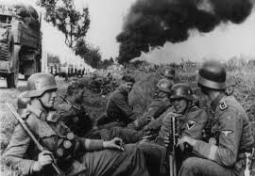
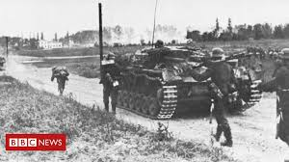
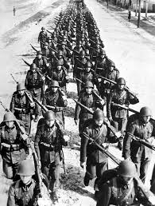
Cont..,

Slide 4
Causes of World War II
The major cause of the second world war II was the German invasion of poland in 1939 subsequently prompting the United Kingdom to declare war on Germany.
The UK prime minister Chamberlain declared war on Germany immediately after this invasion.
British prime ministers during world war II were Neville Chamberlain until 1940 then later on Winston Churchill took over.

Slide 5
Organisation of the war
The battle of Britain, between the German Luftwaffe and the Royal Air Force was the first battle to be fought only in the air.
It was made up of lots air battles that lasted from 10th July to October 1940.
The Luftwaffe used both bombers and fighters in this war. The bombers were specifically used to attack towns and cities and the fighters were to stop RAF fighters from destroying German bombers.

Slide 6
Countries Involved
The main Axis countries were Germany, Italy and Japan.
The main Allied countries included the Great Britain, France, The US and the Soviet Union.
Two types of aeroplane were used in the Battle of Britain – bombers that dropped bombs on towns and cities and fighters that attacked other aeroplanes.

Slide 7
End of the war
World War II ended in Europe on 8 May 1945, his is also known as VE Day (Victory in Europe Day).
World War II carried on for a few months after it ended in Europe, and officially ended when Japan formally surrendered to the Allies on 2 September 1945 (also called VJ Day).

Slide 8
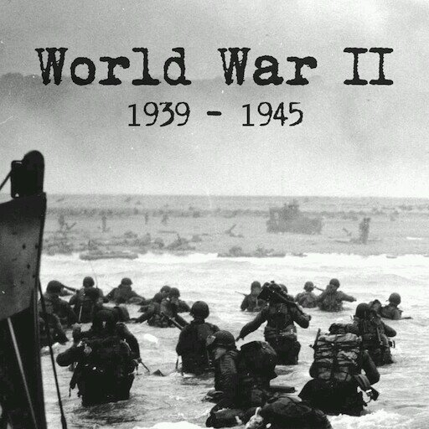
Cont..,
A picture showing
The timeframes of
World war II

Slide 9
References
Ross, S. H. (2015). Strategic bombing by the United States in World War II: The myths and the facts. McFarland.
Ellis, J. (1993). The World War II databook: the essential facts and figures for all the combatants. Aurum Press.
Gale, H. R. (2020). Nothing But the Truthiness: Facts and Fiction in Alternate World War II History Films.

